Slide 1
Geog 714
Principal components analysis

Slide 2
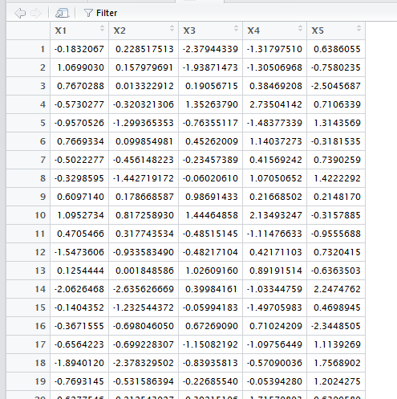

Slide 3
Variance
Mean

Slide 4
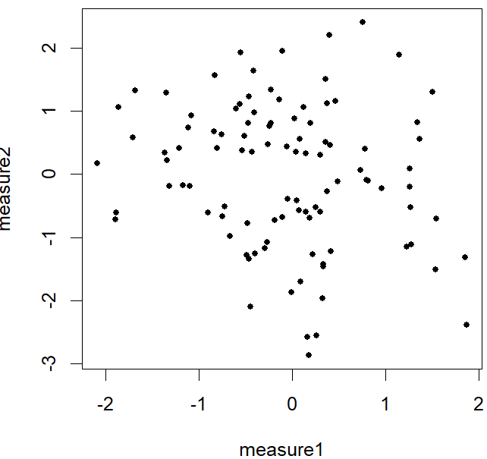
new axis 2
new axis 1

Slide 5
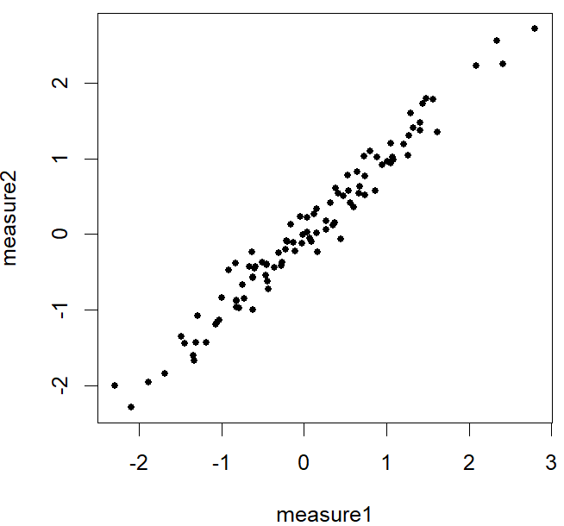
new axis 2
new axis 1

Slide 6
y = β0 + β*measure1 + β*measure2 + error
y = β0 + β*new axis 1 + error
new axis 2
p1 = β0 + β*measure1 + β*measure2
new axis 1
p2 = β0 + β*new axis 1
p1 ~ p2

Slide 7
Principal components analysis (PCA) involves converting multi-dimensional data into another set of dimensions of equal or lesser number to help to better understand this correlated structure
PCA involves reducing the complexity of a data set in the variable dimension
Principal components are synthetic variables that contain/represent maximum variance in data, such that each component is orthogonal (uncorrelated) which all other components

Slide 8
We use PCA when…
The structure of the original data is complex, correlated, and we have a hard time representing it in this raw form
When we want to use indices to represent data (e.g., IQ tests, quality of life indicators, etc.)
When you have many measures and some/all are ‘noisy’
When we think that there may be a few main drivers in a multidimensional dataset, and we want to focus on the main drivers rather than all the variables

